Slide 1

School of Computing Science and Engineering
Course Code : BCS01T1001 Course Name: Data Analytics
UNIT IV
Advanced Graphing and Charting
Name of the Faculty: Bibhas Kumar Rana Program Name: B.Tech

Slide 2

Software process and Process Models
Advanced Graphing and Charting
Advanced visualizations
Venturing on to Advanced Visualizations, at variations of some fundamental visualizations, such as bar charts, time series, distributions, and scatterplots.
Tableau's amazing flexibility and are meant to inspire you to think through new ways of seeing, understanding, and communicating your data.
Program Name: B.Tech
2

Slide 3
Software process and Process Models
Advanced Graphing and Charting
Slope Charts
A Slope Chart shows a change of values from one period or status to another.
For example, here is a Slope Chart demonstrating the change in sales rank for each state in the South region from 2016 to 2017:
Program Name: B.Tech
3

Slide 4
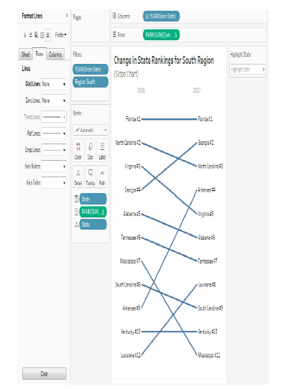
Software process and Process Models
Advanced Graphing and Charting
Program Name: B.Tech
4

Slide 5
Software process and Process Models
Advanced Graphing and Charting
Lollipop Charts
A Lollipop Chart is very similar to a bar chart, but typically uses thinner lines ending in a circle.
This allows for some stylistic interest as well as a place to show values or other labels.
Here, for example, is a Lollipop Chart for Sales of Categories in the Technology department:
Program Name: B.Tech
5

Slide 6
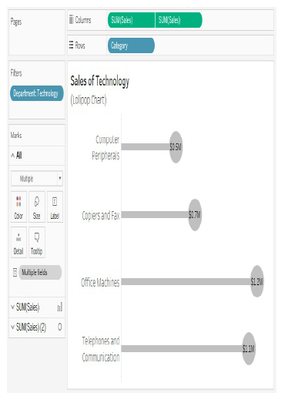
Software process and Process Models
Advanced Graphing and Charting
Program Name: B.Tech
6

Slide 7
Software process and Process Models
Advanced Graphing and Charting
Waterfall Charts
Waterfall Chart is useful when you want to show how parts successively build up to a whole.
In the following screenshot, for example,is a Waterfall Chart showing how profit builds up to a grand total across Departments and Categories of products. Sometimes profit is negative, so at that point the Waterfall Chart takes a dip, while positive values build up
toward the total:
Program Name: B.Tech
7

Slide 8
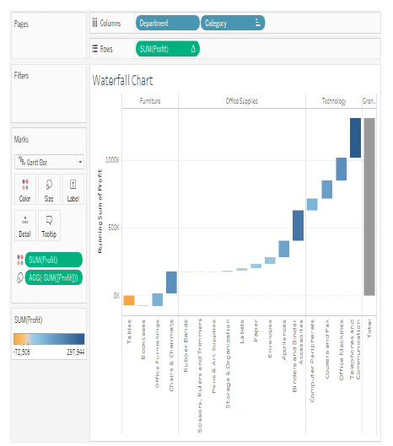
Software process and Process Models
Advanced Graphing and Charting
Program Name: B.Tech
8

Slide 9
Software process and Process Models
Advanced Graphing and Charting
Dumbbell Charts
A Dumbbell Chart is a variation of the circle plot that compares two values for each slice of data, emphasizing the distance between the two values.
Here for example, is a chart showing the Difference in Profit between East and West regions for each Category of products:
Program Name: B.Tech
9

Slide 10
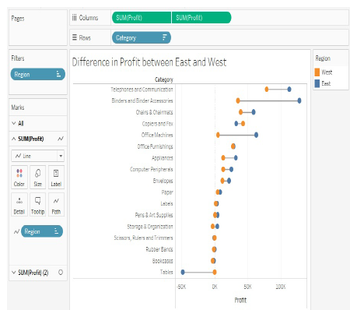
Software process and Process Models
Advanced Graphing and Charting
Program Name: B.Tech
10

Slide 11
References
https://www.slideshare.net/HimadriShekhar2/charts-and-graphs-47417340
Learning Tableau 2019 Tools for Business Intelligence, data prep, and visual analytics by Joshua N. Milligan, 3rd Edition, 2019
Program Name: B.Tech

Slide 12
Software process and Process Models
Contact Information
Program Name: B.Tech
12

Slide 13


